Slide 1
MMO MPA Fisheries Management
Non-UK Fisheries Stakeholders

Slide 2
UK MPA Roles and responsibilities
Government department
Regulators
Advisors
Defra
IFCAs
< 6 nm
Natural England
< 12 nm
Marine and fisheries policy
Designates MPAs
Confirming MMO byelaws
MMO
> 6 nm
JNCC
> 12 nm
MPA designation - advisory role
Provide conservation advice
Monitor MPA feature condition

Slide 3
Background – Offshore MPA fisheries management
The UK Fisheries Act 2020 introduced new powers for MMO to make byelaws to manage fishing for the purpose of conserving marine species and habitats.
MMO is now using our new powers to contribute to the government's ambition for marine nature recovery and a sustainable fishing industry.
MMO has worked closely with Defra, JNCC and Natural England to agree and enact a staged programme of work, to assess and manage all fishing in offshore MPAs by the end of 2024.

Slide 4
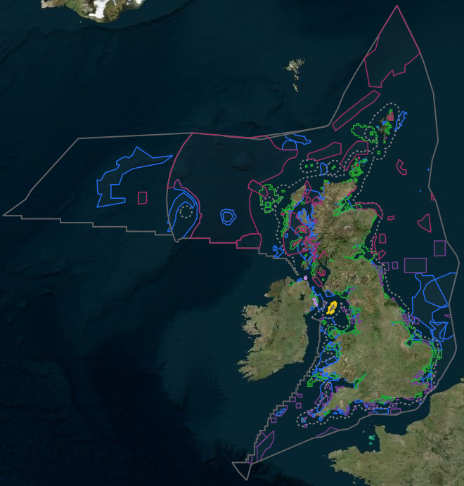
Background - MPAs
178 MPAs in English waters (157 inshore/40 offshore)
Cover 38% of UK/40% English waters
Feature based approach
Mix of SACs, SPAs and MCZs
Legal duty on MMO to ensure the activities we regulate are compatible with the conservation objectives set for each site
Conservation objectives = recover to/maintain at favourable condition
Site-level assessments to understand which fishing activities are compatible
Management primarily through MMO byelaws

Slide 5
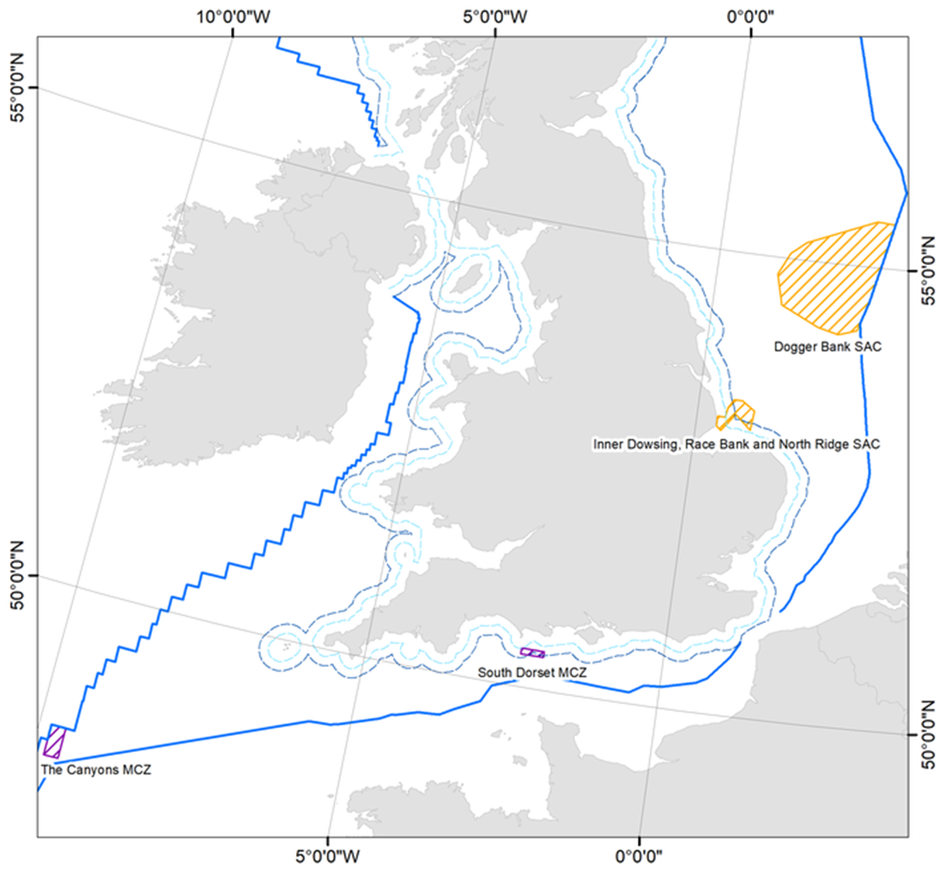
Stage 1
Work to date: Stage 1
MMO undertook evidence-based assessments of fishing activities in four initial MPAs:
Dogger Bank SAC
Inner Dowsing, Race Bank and North Ridge SAC
South Dorset MCZ
The Canyons MCZ
Based on the conclusions of these assessments, MMO developed and consulted on four draft byelaws.
These new byelaws came into force on 13 June 2022.

Slide 6
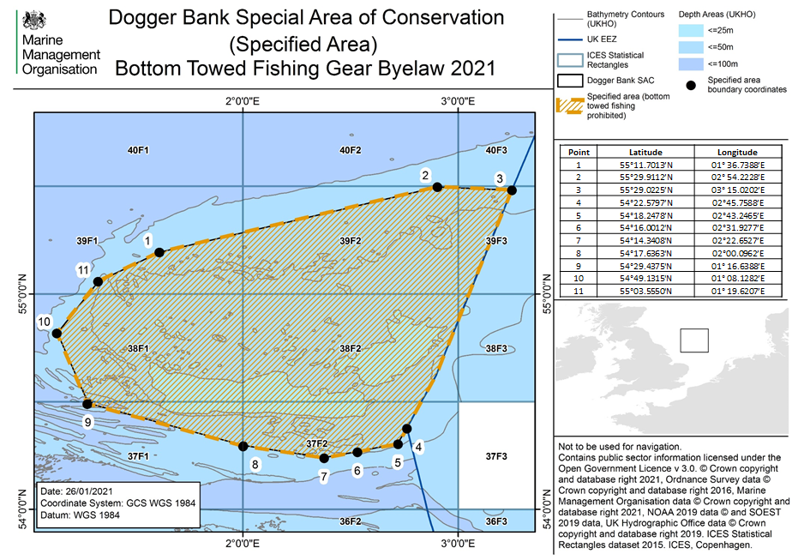
Work to date: Stage 1
Management: prohibition on all bottom towed fishing, including demersal and semi-pelagic trawls, demersal seines and dredges throughout the SAC to protect sandbank.
Management area - 12,388 km²

Slide 7
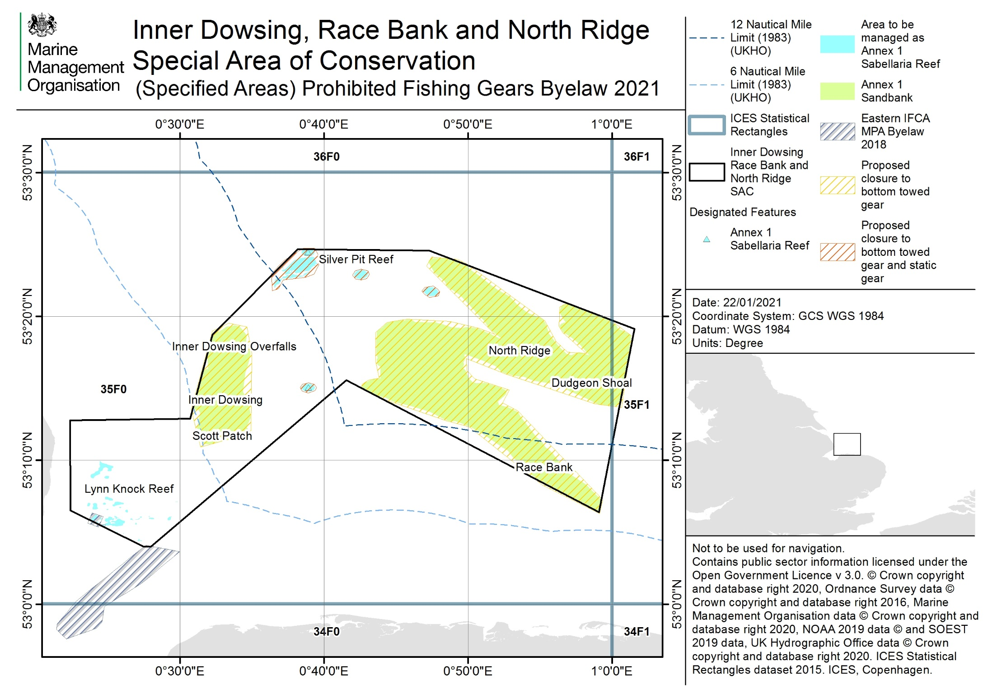
Work to date: Stage 1
Management: prohibition of bottom towed fishing over the sandbank and biogenic reef features of the site, and prohibition of static gear fishing over the biogenic reef features.
Total management area – 351 km²

Slide 8
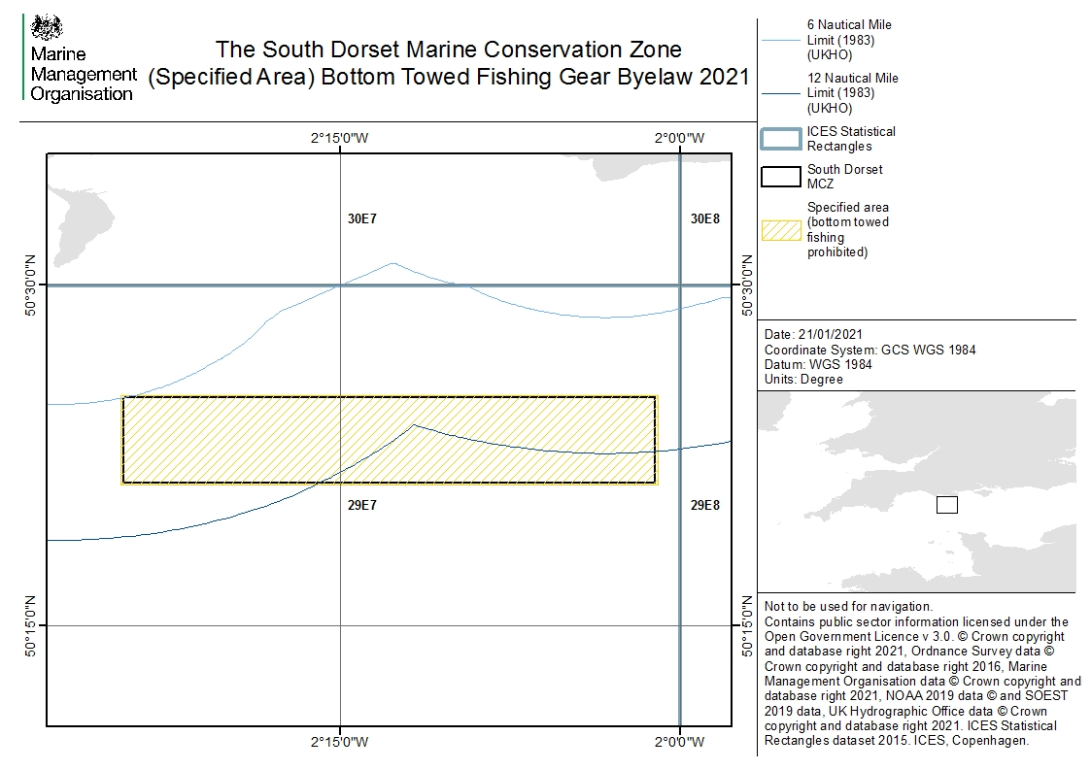
Work to date: Stage 1
Management: prohibition on all bottom towed fishing, including demersal and semi-pelagic trawls, demersal seines and dredges throughout the MCZ to protect subtidal coarse sediment, subtidal chalk and reef.
Total management area – 204 km²

Slide 9
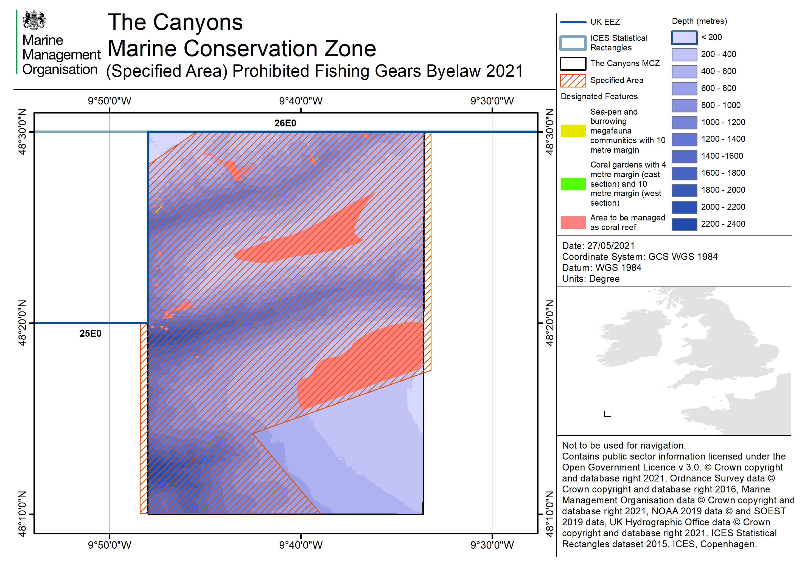
Work to date: Stage 1
Management: prohibition on all bottom towed fishing gear and anchored nets and lines within a zoned area to protect the coral garden, cold-water coral reef, deep-sea bed, and sea-pen and burrowing megafauna communities features.
Total management area – 574 km²

Slide 10
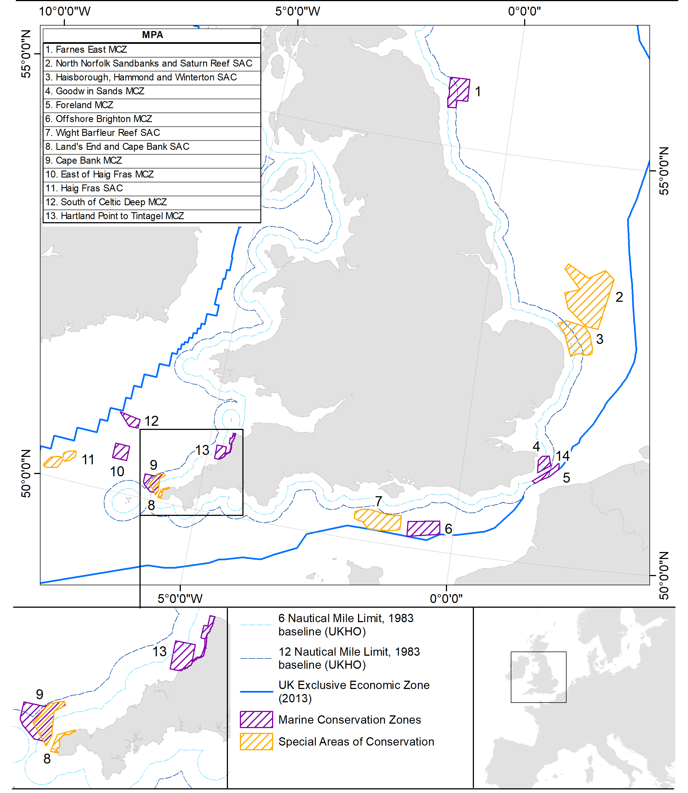
Work to date: Stage 2
For Stage 2 MMO is assessing and will manage interactions between bottom towed fishing gears and rocky/biogenic reef features in 13 MPAs.
One assessment for all Stage 2 sites and features.
Call for evidence on draft assessment closed 10 July 2022.
Currently reviewing responses and preparing a formal response.
Management measures will be subject to formal consultation.

Slide 11
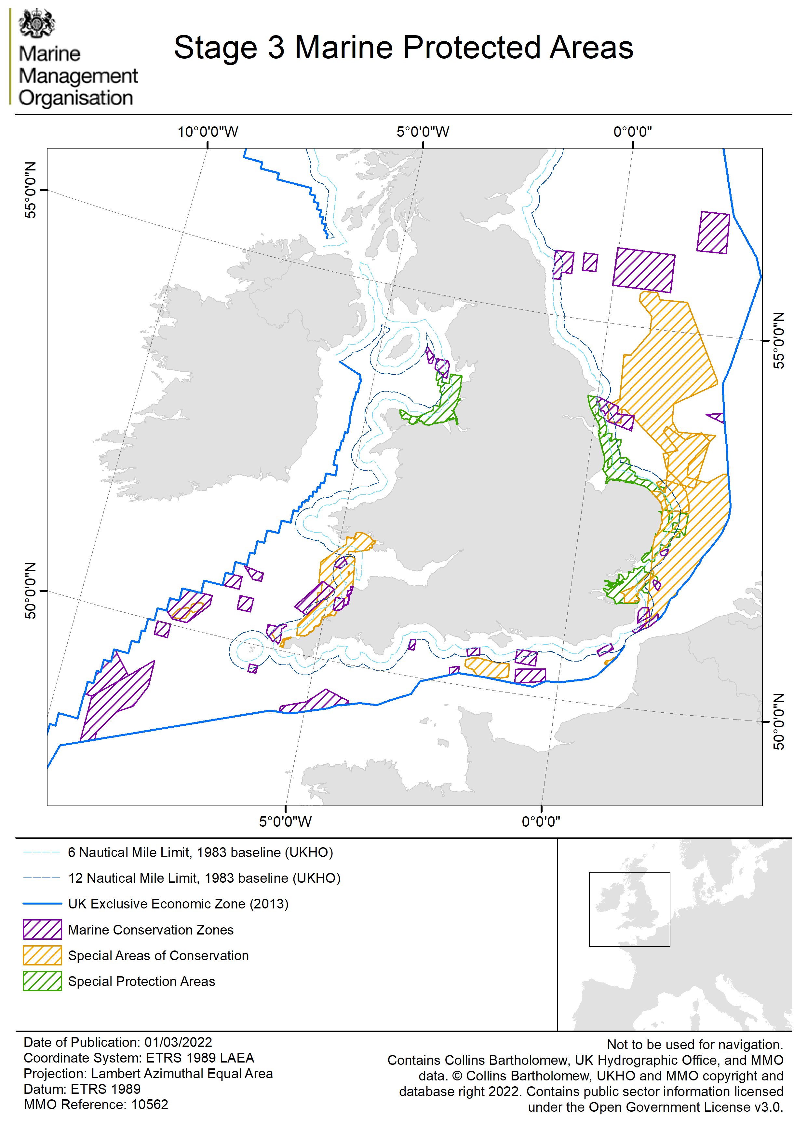
Next Steps: Stage 3
Stage 3 includes all fishing activities in all remaining MPAs.
Stage 3 will cover all fishing in 33 MPAs plus all remaining interactions in Stage 2 sites.
MMO have been collating and analysing all available evidence on the interactions between fishing and MPA features.
Site-level assessments will be completed, with any required management in place by the end of 2024.

Slide 12
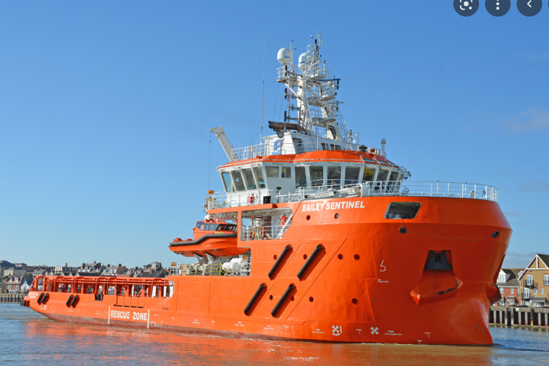
Monitoring and control
Compliance monitoring through:
VMS, direct surface and aerial surveillance – MMO assets have visited sites multiple times
Coordination with EU MS fisheries monitoring centres (FMCs)
Very high levels of compliance to date
Series of compliance options from verbal advice, written warning to criminal prosecution
Monitoring and control

Slide 13
Any questions?

