Slide 1
MMO MPA Fisheries Management Update
January 2024

Slide 2
Contents
Background and overview
Stage 2 update
Stage 3 update
HPMA update
Stage 4 update & discussion
Call for evidence overview
Marine birds call for evidence topics
Harbour porpoise call for evidence topics
How to respond
Next steps
Questions
AOB

Slide 3
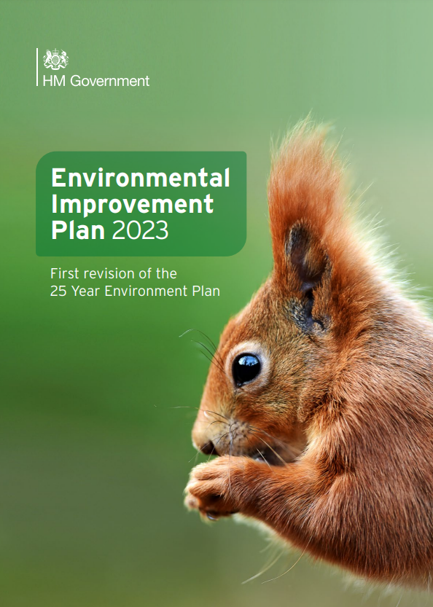
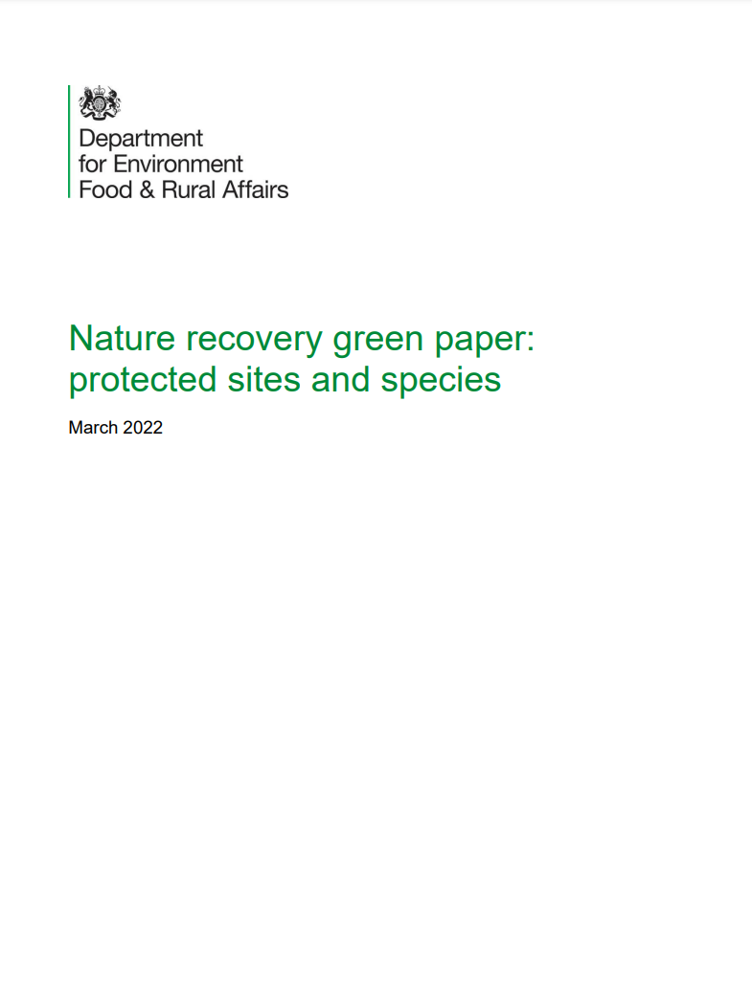
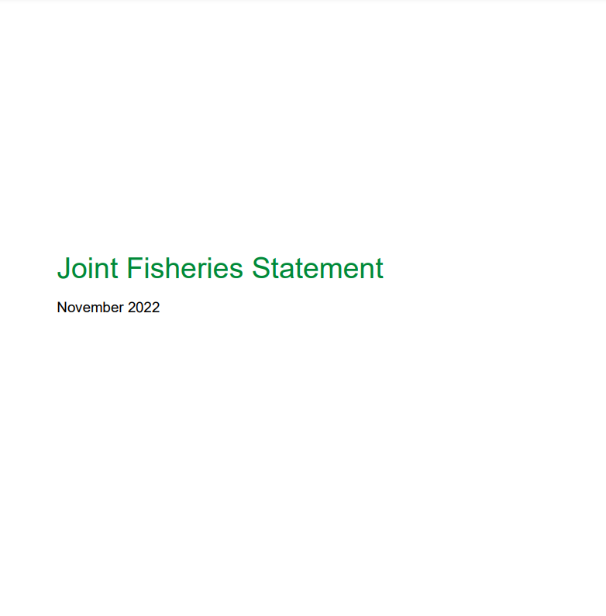
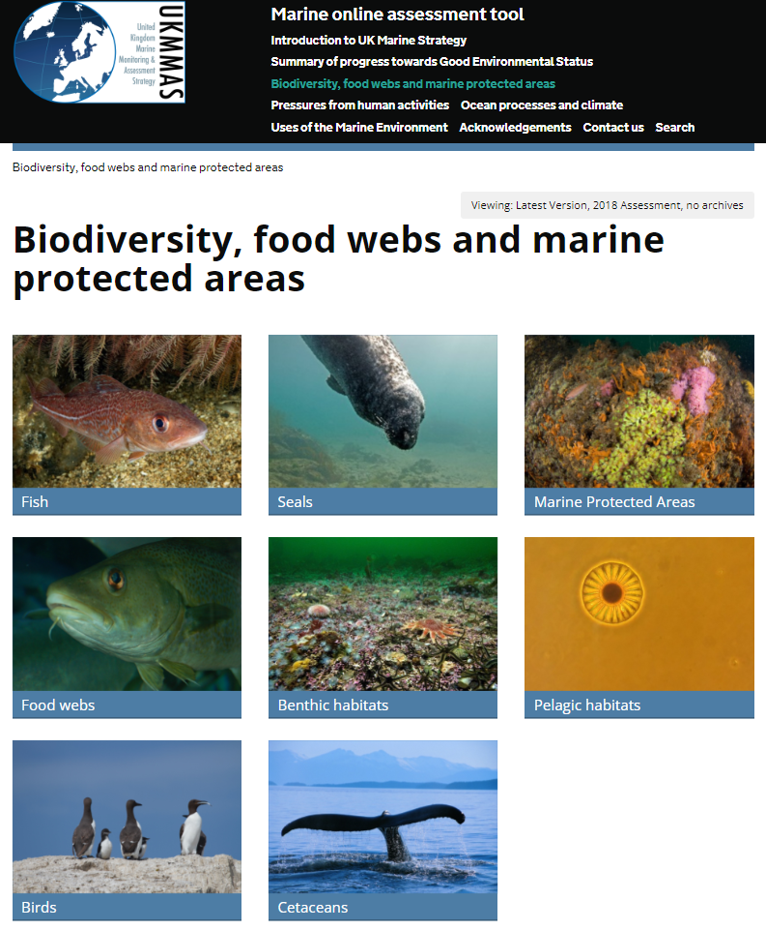
Background
Protect designated habitats and species
Maintain or restore ecosystem function
Stop biodiversity loss
Protect ecosystem services:
fish and shellfish stocks, nutrition employment, climate regulation, clean water, coastal protection, tourism, recreation​

Slide 4
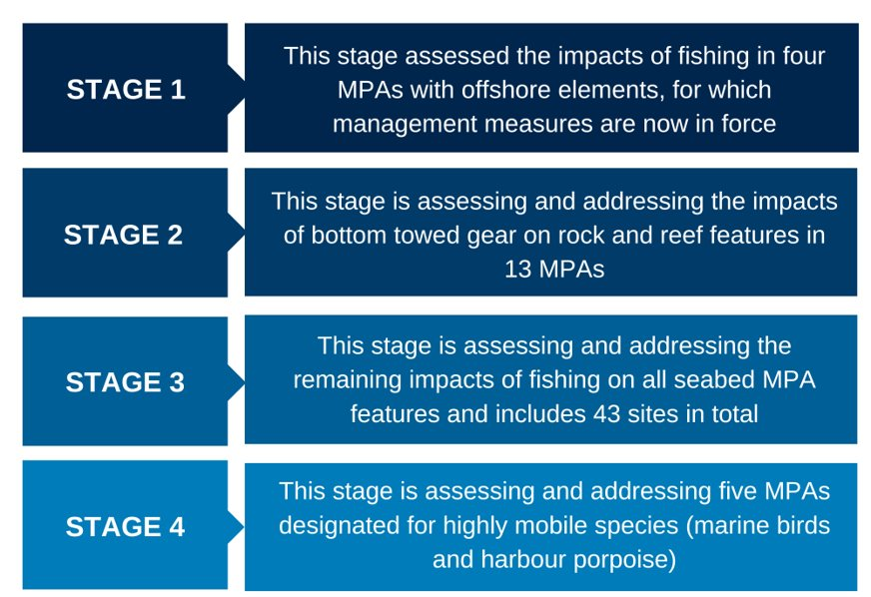
Overview

Slide 5
Offshore MPA Fisheries Management Timeline
February
April
June
January
March
September
November
Stage 1
Byelaws draft (complete)
Stage 1 Make Byelaws (complete)
Stage 1 Byelaws into force (complete)
Stage 3
C4E launch (complete)
Stage 3
Launch formal consultation
Stage 3
Make byelaws
Stage 3
Byelaws
come into force
Stage 3
Site assessment drafting
2022
2023
2024
Stage 4
Site assessment drafting
May
January
October
November
March
May
October
December
Stage 2
C4E launch (complete)
Stage 2
Formal consultation launch (complete)
Stage 2
Make Byelaws
Stage 4
C4E launch
Stage 2
Byelaws come into force
Stage 4
Launch Formal Consultation
Stage 4
Make byelaws
Stage 4
Byelaws
come into force

Slide 6
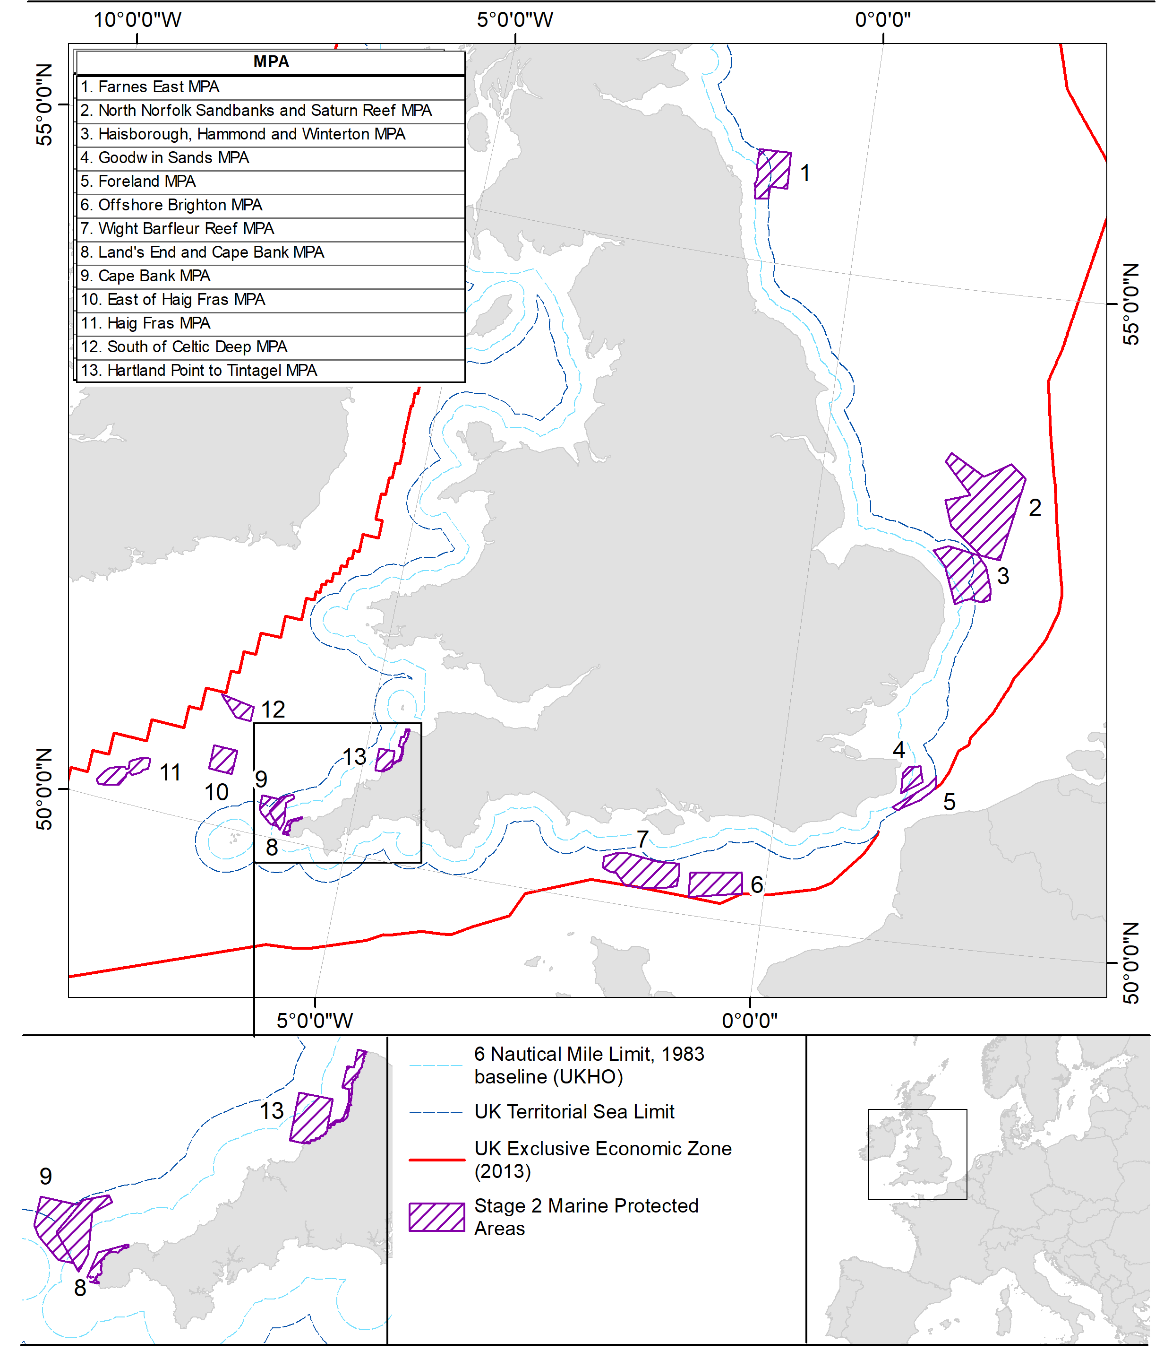
Stage 2
13 MPAs assessed for impacts of bottom towed fishing gear over rocky and biogenic reef features.
Zoned management introduced for 7 sites. Full site closures to bottom towed gear for the remaining sites due to the extent or distribution of the feature.
Estimated annual landings in closed areas for bottom towed gear: UK = £252,363. Non-UK = £1,615,795.
Estimated annual net direct cost to business (UK only) = £37,921.
The byelaw is now in the final stages of development and is likely to be confirmed in early 2024. The implementation date will be 50 days after confirmation.

Slide 7
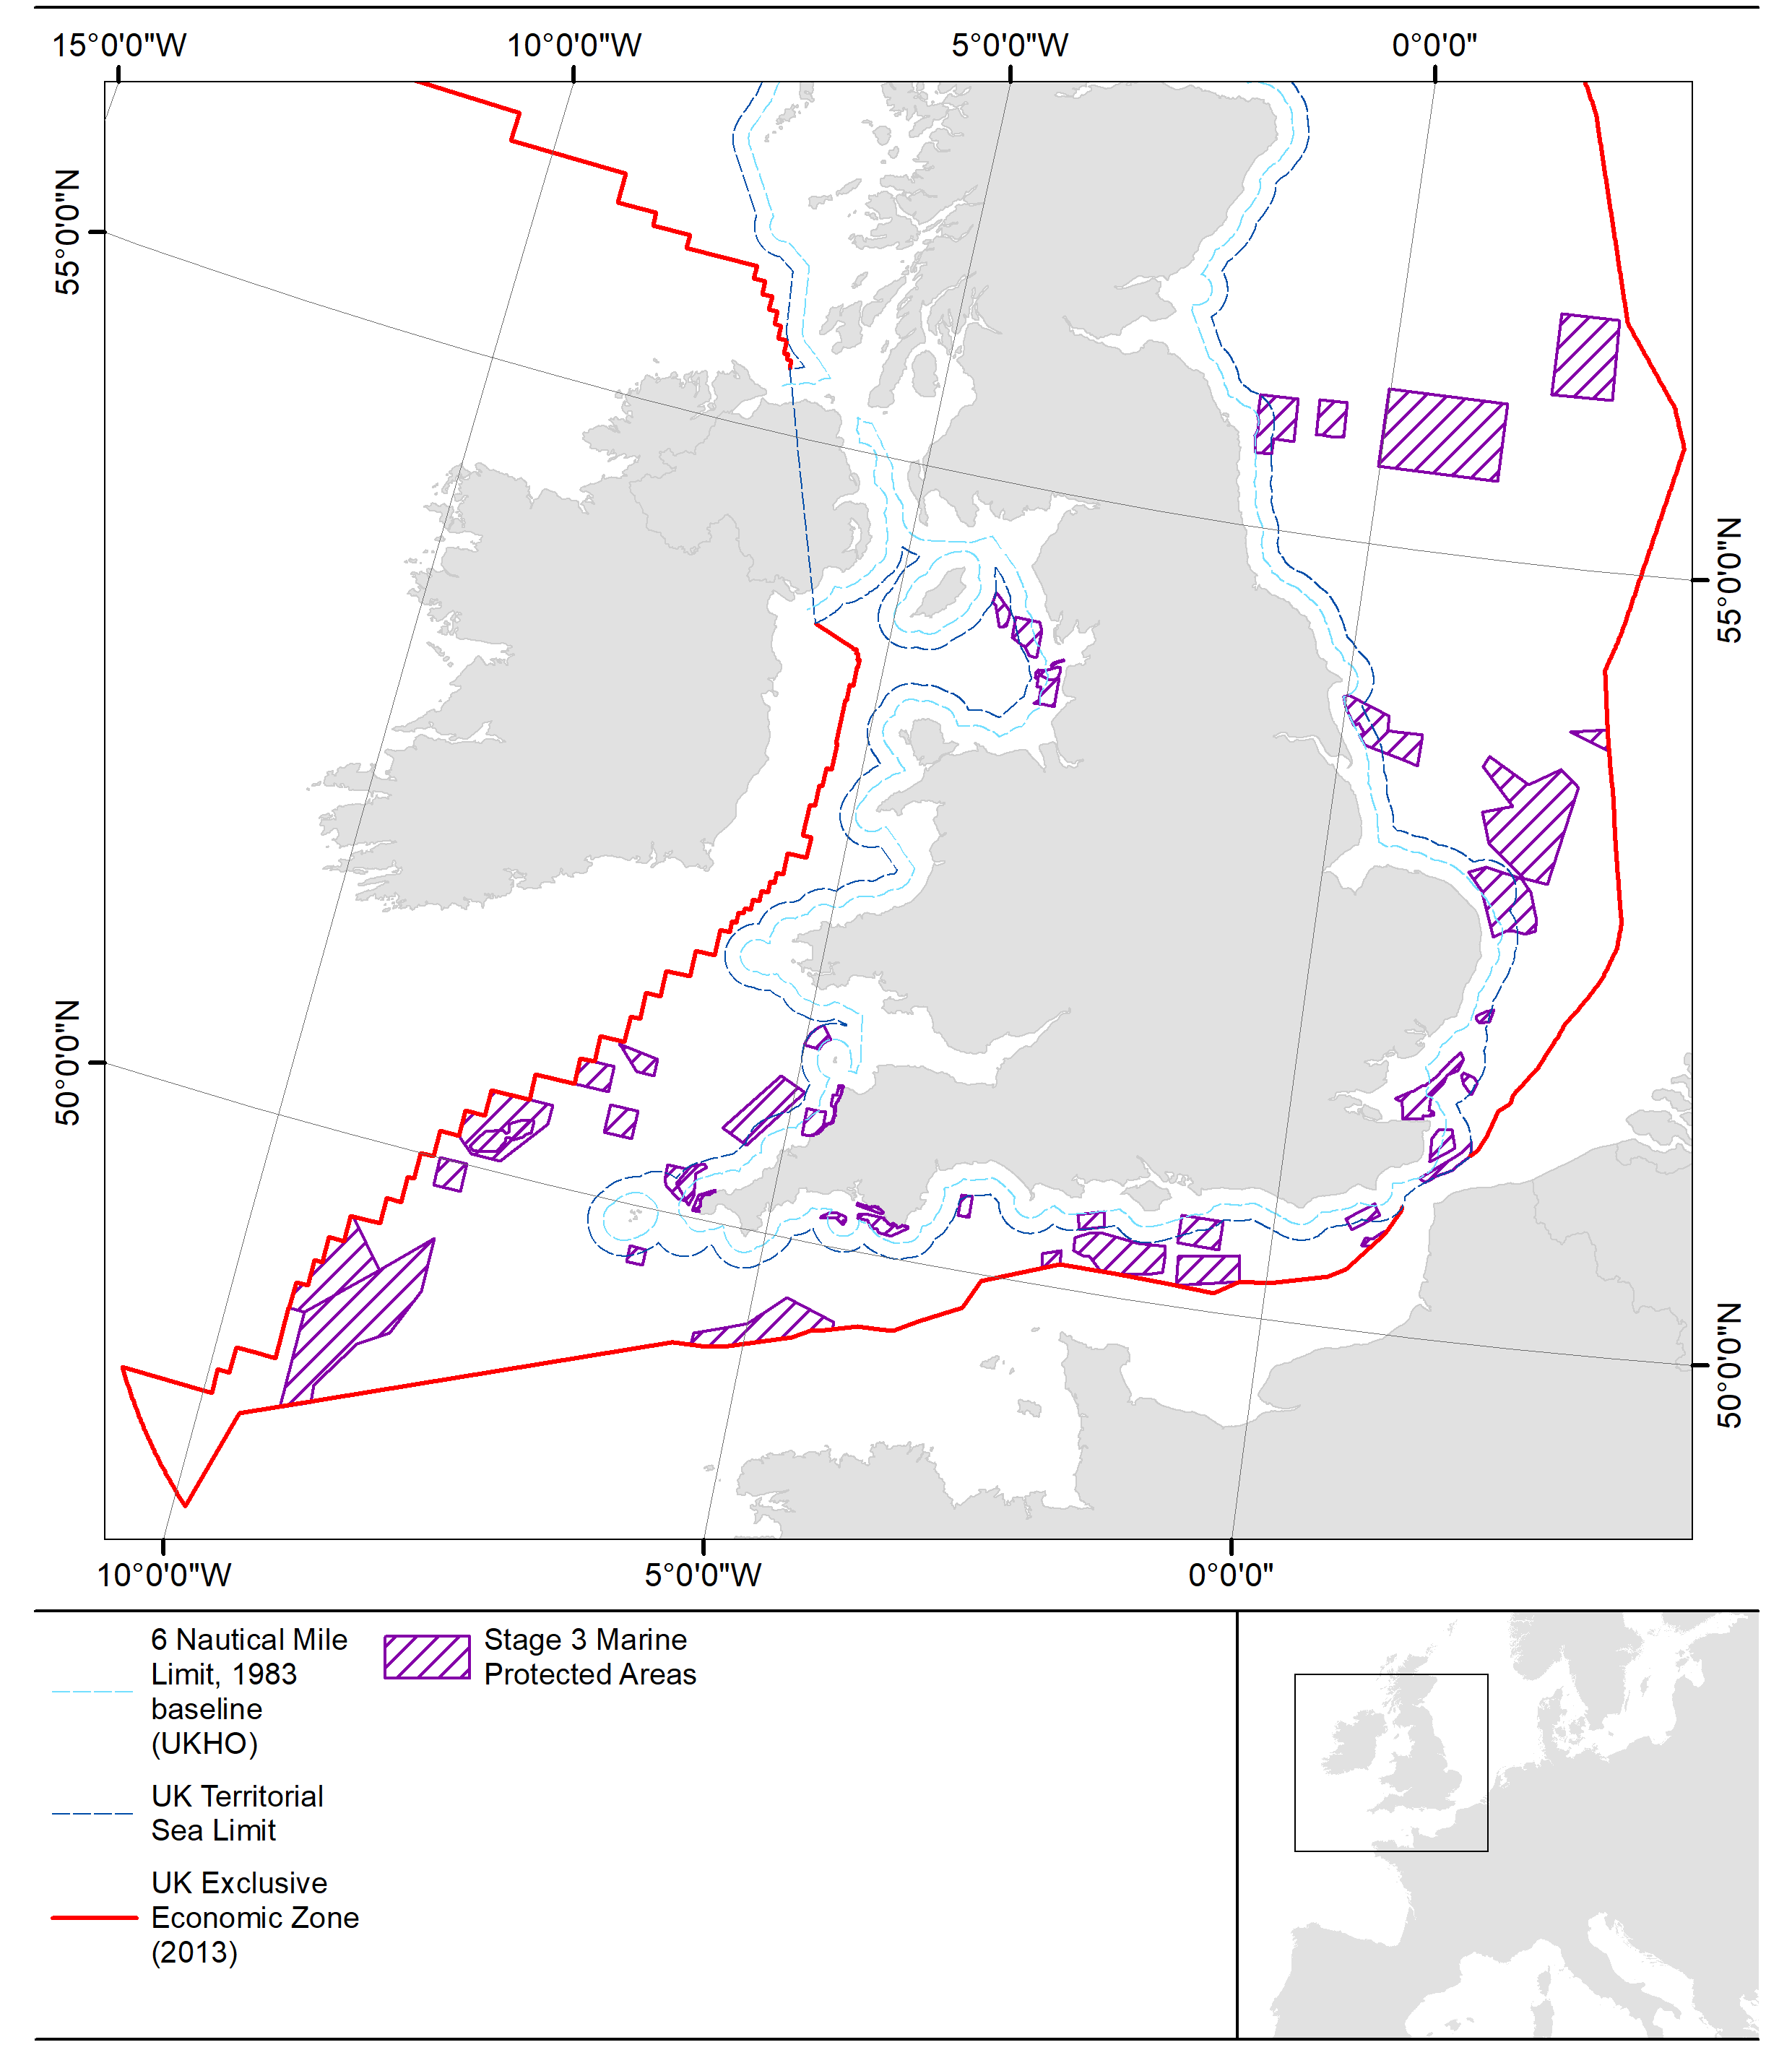
Stage 3 - progress
Currently finalising site assessments utilising Impacts Evidence documents and advice from SNCBs; 43 assessments in total.
Mott MacDonald supported drafting of 16 Site Assessments to help achieve 2024 targets.
Drafting:
decision document: consideration of responses received during call for evidence
impact assessments (de minimis assessments): socio-economic impacts
byelaws. (see map; MPAs not management areas)
Formal consultation on proposed management planned Spring (end of March) 2024.
Following the consultation, we will review our proposals, make any necessary changes and finalise byelaws.
Any required management to be in place by the end of 2024.

Slide 8
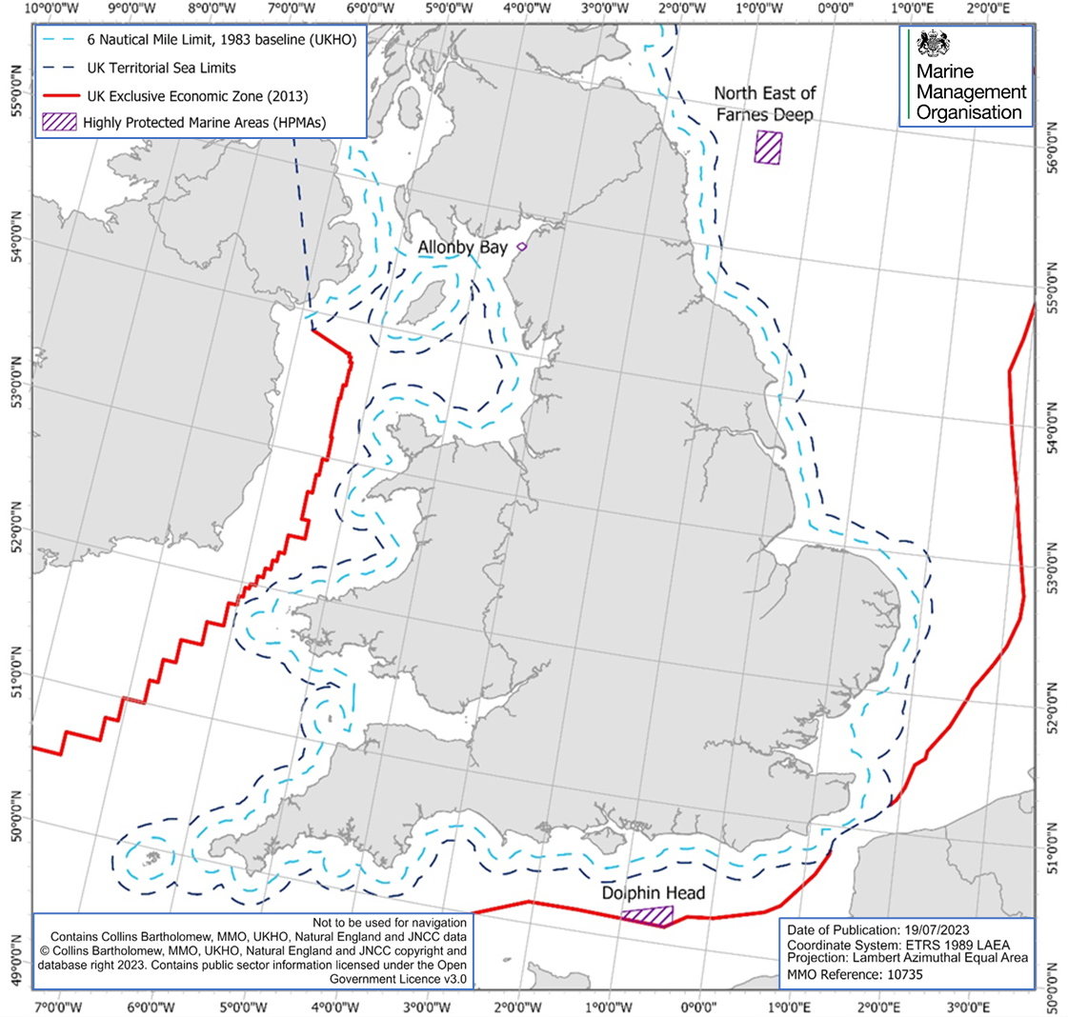
HPMAs
Defra designated 3 HPMAs
Allonby Bay
Dolphin Head
North East of Farnes Deep
“anticipated that extractive, destructive and depositional activities will be prohibited within each site”
Proposed MMO Highly Protected Marine Areas Fishing Byelaw 2024 to prohibit fishing throughout HPMA & small surrounding areas
Formal Consultation closed 14 Sept 2023
Reviewed and updated documentation
Aiming to make byelaw early 2024

Slide 9
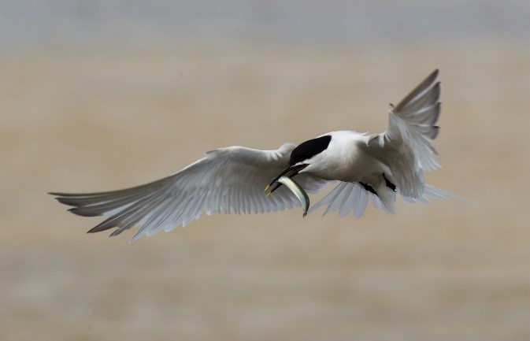
Stage 4 MPAs
Stage 4: assessing and addressing impacts on MPAs designated for highly mobile species (harbour porpoise and marine birds)
Marine bird MPAs
Liverpool Bay MPA
Outer Thames Estuary MPA
Greater Wash MPA
Harbour porpoise MPAs
Bristol Channel Approaches MPA
Southern North Sea MPA
We will assess impacts of fishing on the relevant marine bird species and harbour porpoise protected in these MPAs (including seasonality).
This may consider their supporting habitat, where there are impacts on their prey species.
Sandwich tern. Natural England / Allan Drewitt
Harbour porpoise. Natural England/Rebecca Walker

Slide 10
Stage 4 call for evidence
Stage 4 Call for Evidence
Topic 1
Topic 2
Topic 3
Impacts evidence documents - executive summary
Introduction document
Pressures of interest
Potential management options
Marine birds impacts evidence document
Harbour porpoise impacts evidence document
Pressures are the ways that an activity can impact marine birds or harbour porpoise.
We have listed possible options to manage or mitigate the impacts of the pressures of interest identified
Pressures of interest identified through drafting impacts evidence documents
Inclusion of pressures and management options in this call for evidence does not mean they will be taken forward

Slide 11
Call for evidence topics
Topic 1: Impacts Evidence - marine birds & harbour porpoise
Outline the best available evidence for the impacts of fishing on harbour porpoise MPA features at the time of drafting.
National, gear-feature interaction level
Summary document
Include consideration of the supporting habitat and prey species.
Will inform site level assessments of the impact of fishing on the Stage 4 MPAs.
will be used alongside site level evidence and data.
Impacts evidence documents - executive summary
Marine birds impacts evidence document
Harbour porpoise impacts evidence document
Call for evidence questions
Do you have any additional evidence about the interactions between fishing and marine birds or harbour porpoise? Do you have any comments on the evidence and analysis currently included in the Impacts Evidence documents?

Slide 12
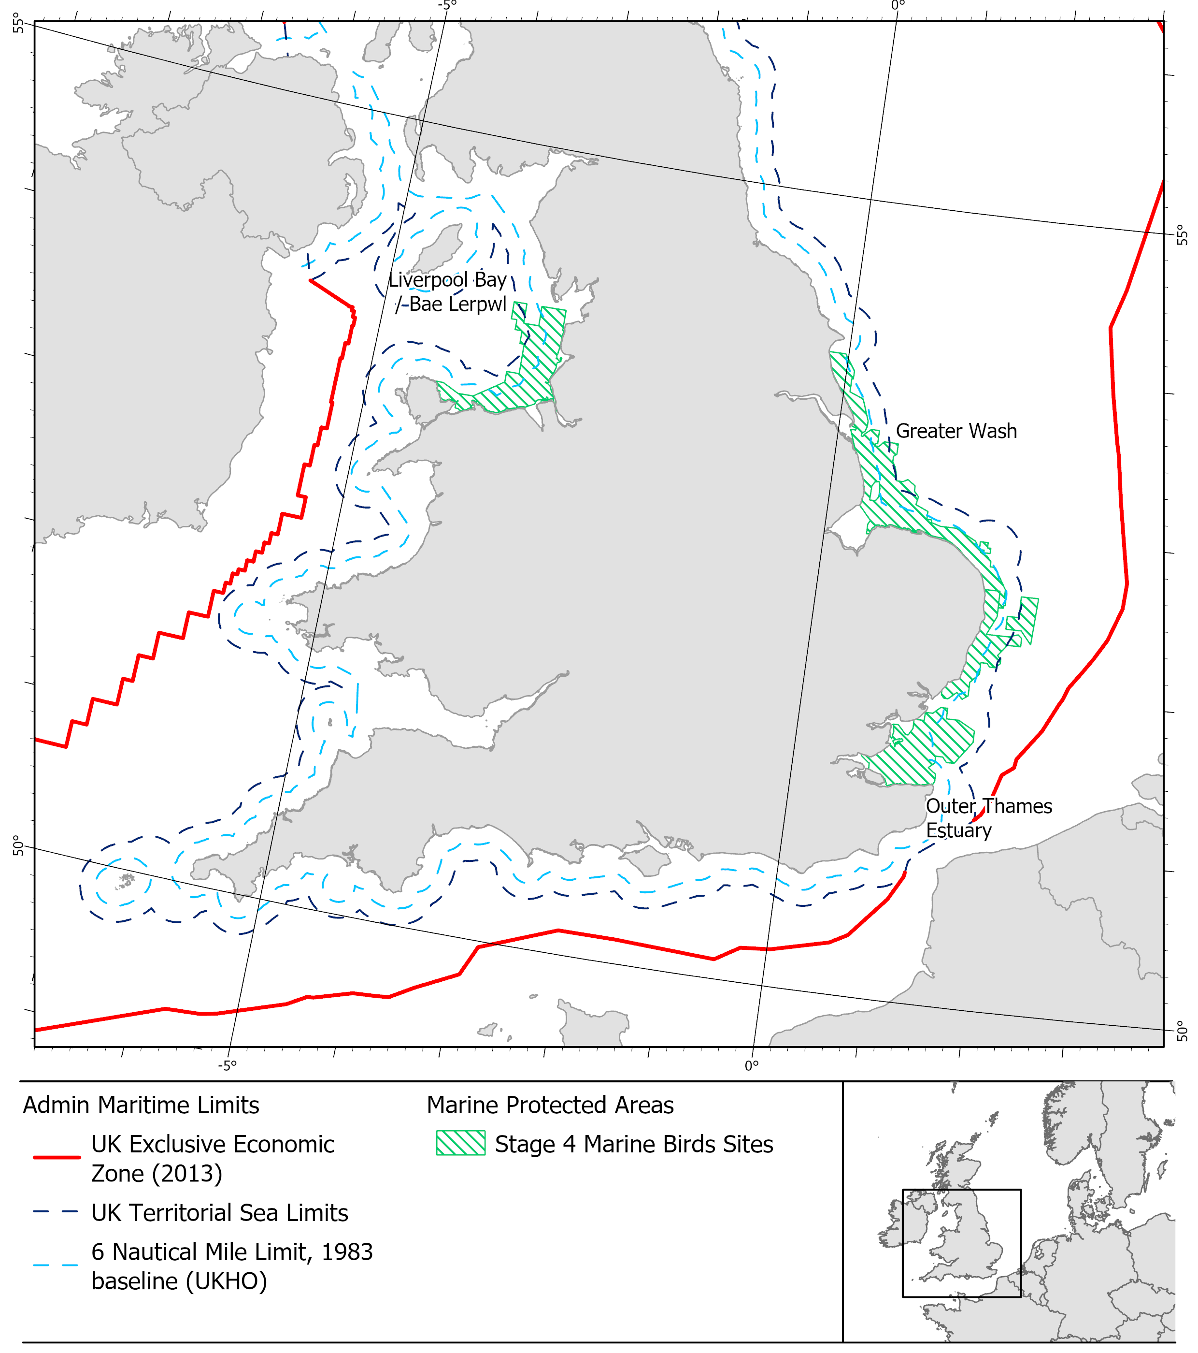
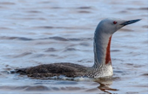
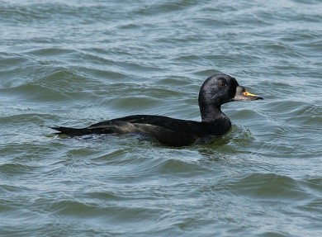
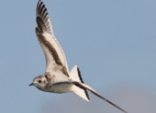
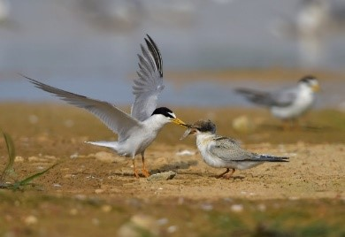
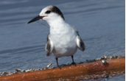
Stage 4 MPAs
Marine bird MPAs
MMO assessing the sections of these MPAs outside 6 nautical miles.
Red-throated diver
Sandwich tern
Common scoter
Greater Wash
Liverpool Bay
Outer Thames Estuary
Greater Wash
Greater Wash
Liverpool Bay
Little gull
Little tern
Common tern
Greater Wash
Liverpool Bay
Greater Wash
Liverpool Bay
Outer Thames Estuary
Greater Wash
Liverpool Bay
Outer Thames Estuary
Harbour porpoise. Natural England/Rebecca Walker
Waterbird assemblage also designated in Liverpool Bay

Slide 13
Marine birds call for evidence topics
Topic 2: Pressures of interest
Pressure | Activity
Noise and visual disturbance (non-physical disturbance) | Fishing vessel presence (all gears)
Impacts to prey availability through impacts to supporting habitat | Bottom towed gear
Marine bird bycatch | Anchored nets and lines
Death or injury by collision | Fishing vessel presence (all gears)
Impacts to prey availability through removal of prey species | Bottom towed gear, midwater towed gear, purse seines
Highlighted rows = identified as ‘important pressures
of interest’, these are pressures that the evidence and data considered so far is
leading us to focus on.
Call for evidence questions
Do you have any evidence for any of the listed pressures in relation to fishing in Greater Wash, Liverpool Bay or Outer Thames Estuary MPA?

Slide 14
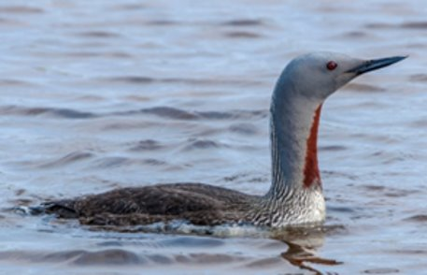
Marine birds call for evidence topics
Topic 2: Pressures of interest
Red-throated diver
Non-physical disturbance
Visual disturbance towards red-throated diver and common scoter is a key pressure we are exploring.
It is challenging to understand and quantify how different activities are contributing to visual disturbance.
Fishing vessels
Non-fishing vessels – e.g. shipping, aggregate dredging vessels, windfarm traffic
Plans and projects – e.g. windfarms
Managing fishing disturbance would not resolve disturbance caused by multiple sectors
Do you have any evidence related to disturbance caused by fishing vessels on these bird species?
Common scoter

Slide 15
Marine birds call for evidence topics
Topic 3: Potential management options
Call for evidence questions
Are you aware of any other management options for any of the pressures?
Do you have examples of any of the management options being used?
Do you have any evidence on the effectiveness of any of the management options?
Pressure | Potential management options
Noise and visual disturbance (non-physical disturbance) | Spatial closures and /or seasonal closures. Reduce effort in specified areas and/or seasons Mitigation measures.
Impacts to prey availability through impacts to supporting habitat (spawning/ nursery grounds) | Spatial and/or seasonal closures. Reduce effort in specified areas and/or seasons.
Marine bird bycatch | Spatial closures and /or seasonal closures. Reduce effort in specified areas and/or seasons. Mitigation measures
Death or injury by collision | Spatial and/or seasonal closures. Reduce effort in specified areas and/or seasons. Mitigation measures.
Impacts to prey availability through removal of prey species | Restrict gear types taking important prey species. Reduce effort for important prey species.
Assessments are in progress and decisions have not been made on management

Slide 16
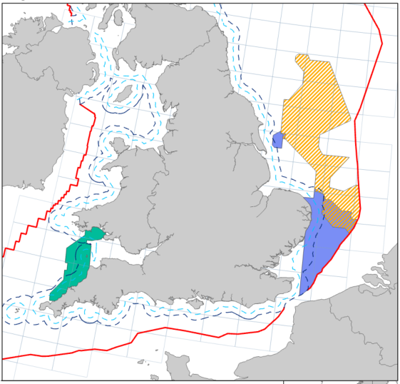
Stage 4 MPAs
Harbour porpoise MPAs
MMO assessing the sections of these MPAs outside 6 nautical miles.
Seasonal considerations:
Bristol Channel Approaches: Persistently higher densities during winter.
Southern North Sea: Two thirds of site (northern / offshore) important during summer. Two areas (southern / inshore) higher densities in winter.
Harbour porpoise. Natural England/Rebecca Walker

Slide 17
Harbour porpoise call for evidence topics
Topic 2: Pressures of interest
Pressure | Activity
Harbour porpoise bycatch | Anchored nets
Impacts to prey availability through removal of prey species | Bottom towed gear, midwater towed gear
Noise disturbance | Fishing vessel presence (all gears)
Death or injury by collision | Fishing vessel presence (all gears)
Impacts to prey availability through impacts to supporting habitat | Bottom towed gear
Highlighted rows = identified as ‘important pressures
of interest’, these are pressures that the evidence and data considered so far is
leading us to focus on.
Call for evidence questions
Do you have any evidence for any of the listed pressures in relation to fishing in Southern North Sea or Bristol Channel Approaches MPA?

Slide 18
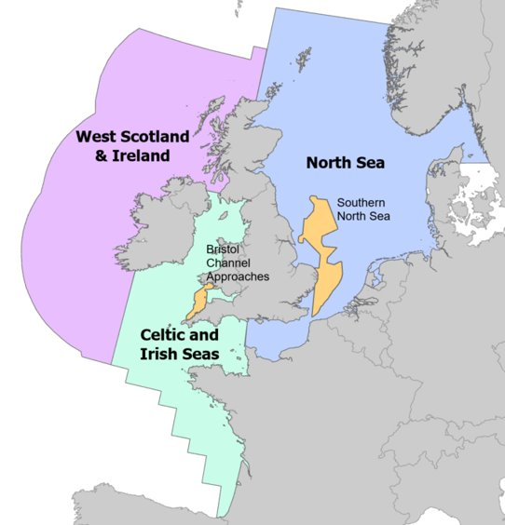
Harbour porpoise call for evidence topics
Topic 2: Pressures of interest
Harbour porpoise bycatch
Results from OSPAR Quality Status Report 2023 and ICES 2021 for harbour porpoise Assessment Units:
Area | Relevant MPA | Bycatch estimate (porpoise / year) |  |  | Bycatch threshold
 |  | All gears | Gillnets | Bottom towed
North Sea | Southern North Sea | Upper estimate: 5929 (3,176 - 10,739) Lower estimate: 1,627 (922 - 3,325) | Upper estimate: 5806 (3,122 - 10,458) Lower estimate: 1,504 (867 - 3,044) | 123 (54 - 281) | 1622 porpoise
Celtic & Irish Seas | Bristol Channel Approaches | 751 (290 - 2,267) | 633 (238 - 1,999) | 118 (52 - 268) | 82 porpoise
Harbour porpoise assessment units (OSPAR, 2022)

Slide 19
Harbour porpoise call for evidence topics
Topic 2: Pressures of interest
Harbour porpoise bycatch
Bycatch of harbour porpoise is a key pressure we are exploring.
Do you have any evidence showing potential hotpots of bycatch in the MPAs?
Particular fisheries
Particular areas or times of year
Do you have evidence on bycatch from different gear types?
Nets
Bottom towed gear
Pelagic gear

Slide 20
Harbour porpoise call for evidence topics
Topic 3: Potential management options
Pressure | Potential management options
Harbour porpoise bycatch | Spatial and/or seasonal closures. Reduce effort in specified areas and/or seasons. Mitigation measures.
Impacts to prey availability through removal of prey species | Restrict gear types taking important prey species. Reduce effort for important prey species.
Noise disturbance | Spatial and/or seasonal closures. Reduce effort in specified areas and/or seasons. Mitigation measures.
Death or injury by collision | Spatial and/or seasonal closures. Reduce effort in specified areas and/or seasons. Mitigation measures.
Impacts to prey availability through impacts to supporting habitat (spawning/ nursery grounds) | Spatial and/or seasonal closures. Reduce fishing effort in specified areas and/or seasons.
Call for evidence questions
Are you aware of any other management options for any of the pressures?
Do you have examples of any of the management options being used?
Do you have any evidence on the effectiveness of any of the management options?
Assessments are in progress and decisions have not been made on management

Slide 21
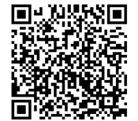
How to respond
Little gull © Ronan McLaughlin
We are seeking additional evidence and views on:
Impacts evidence documents
Pressures are the ways that an activity can impact marine birds or harbour porpoise.
Pressures of interest
Potential management options
Open 5 December to 13 February Survey: consult.defra.gov.uk/mmo/stage-4-call-for-evidence
Alternatively, email conservation@marinemanagement.org.uk or call 0300 123 1032

Slide 22
Stage 4 next steps
Stage 4 call for evidence
Drafting site assessments
Ongoing work on site assessments:
fishing alone impacts on the MPAs.
fishing in-combination with non-fishing activities E.g. plans, projects, shipping
Update documents following call for evidence:
Impacts evidence documents
Site assessments
Inform management options
Develop management options where required.
Consult with stakeholders on proposed options.
Update documents
Develop management options where required
Formal consultation

Slide 23
AOB
conservation@marinemanagement.org.uk

